Slide 1
Lens Update: Parameter Scan, Two Lenses
CaOH Subgroup Meeting
Tuesday, September 8, 2020

Slide 2
Outline
Positioning
Tune-Ups
Two Lenses
WIPs

Slide 3
Experimental Setup: Single Lens
4K Aperture,
1 cm
Beam Shutter,
1.4 cm
2.54 cm
Cell
10 cm
Varied
Lens
MOT Region

Slide 4
Parameter Scan
Yield ratio peaked when lens situated about 30 cm from cell aperture
0.238% yield ratio without lens, >1% yield ratio with lens

Slide 5
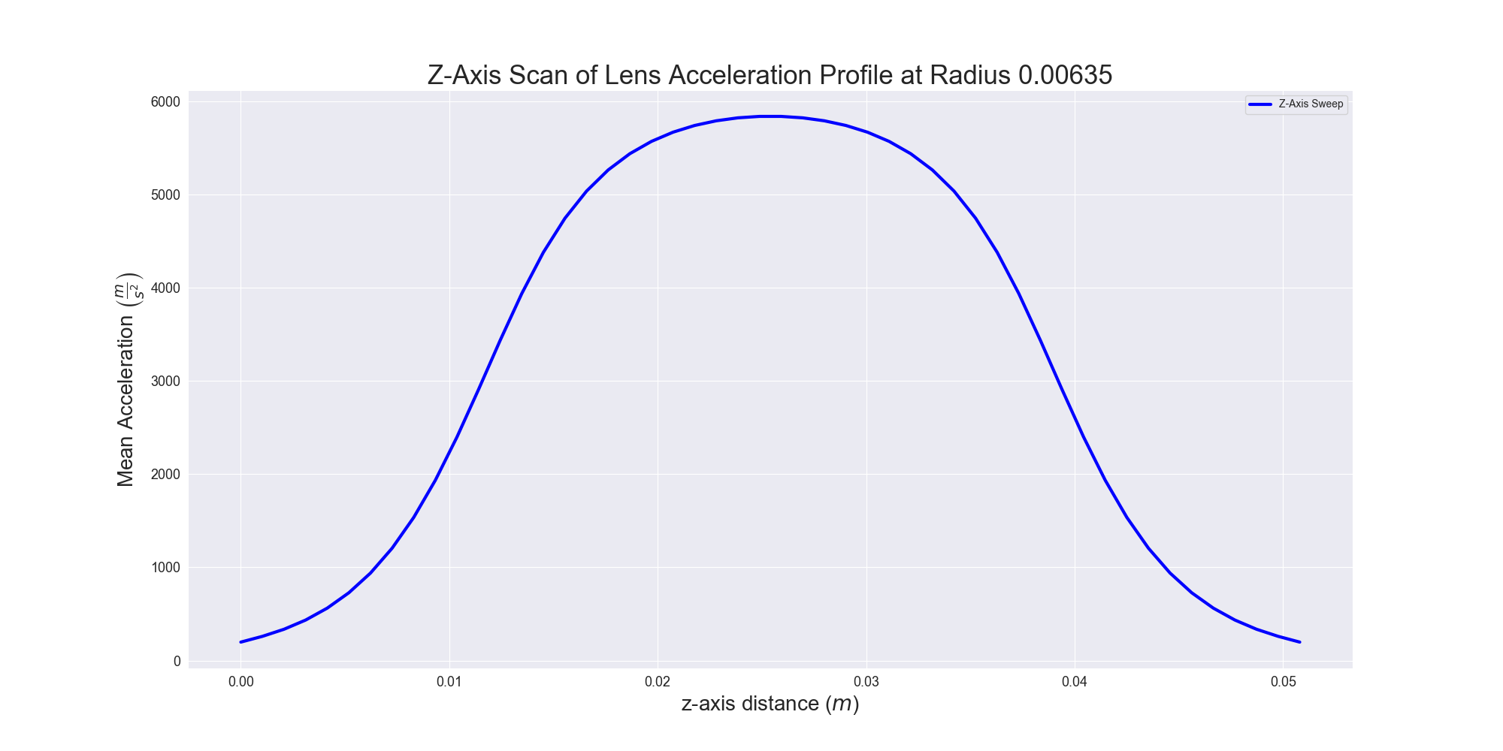
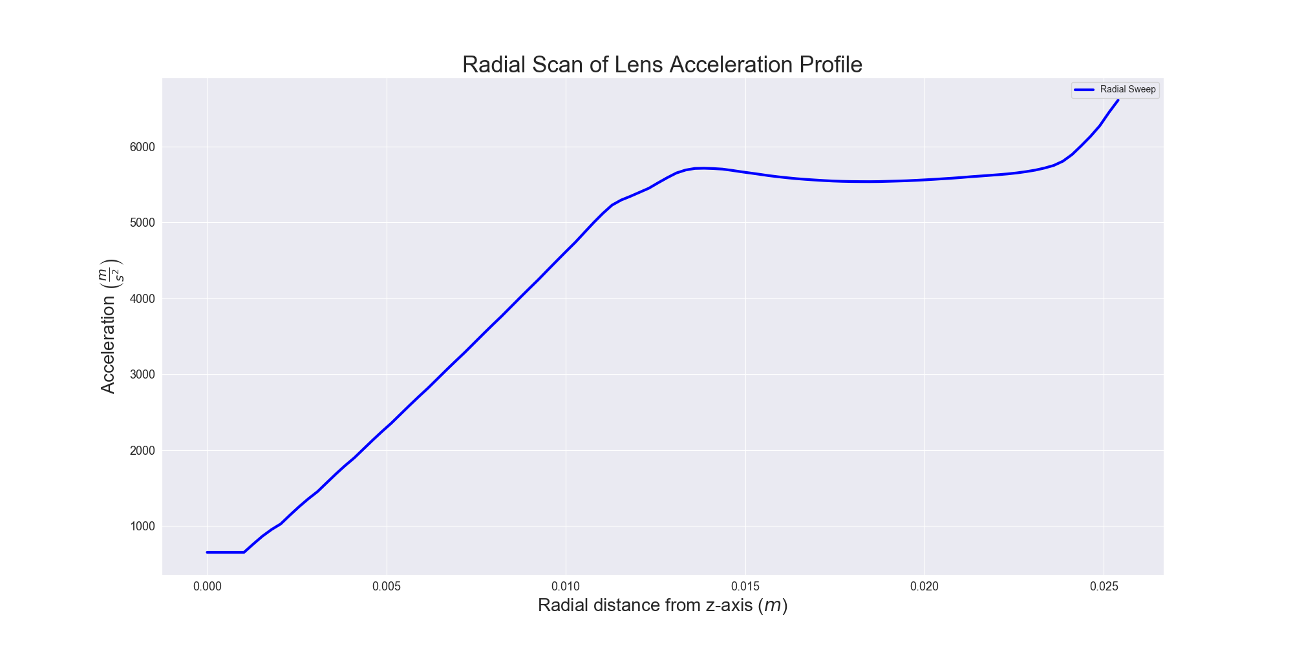

Slide 6
Experimental Setup: Double Lens
4K Aperture,
1 cm
Beam Shutter,
1.4 cm
2.54 cm
2.54 cm
Cell
10 cm
Varied
Lens
Varied
Lens
20 cm
MOT Region

Slide 7
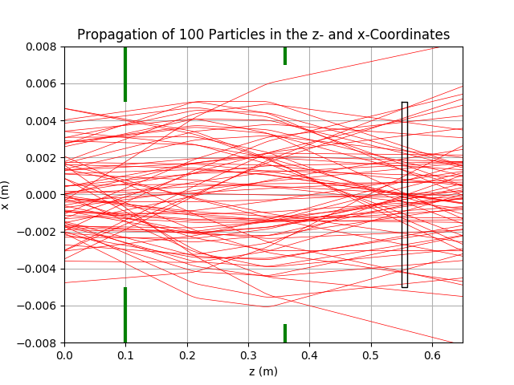
Double Lens: Preliminary Results
Yield ratio: quite high, number enhancement hovers around ~2x that of without any magnetic lens
Still need to generate full heatmap with 2D scan, pipeline WIP

Slide 8
WIP
Two Lens Scan with 2 successive lenses (varying length of magnet)
Laser slowing
Long-term: Zeeman-Sisyphus
Simple analytical form of B-field
Accurate B-field model, spin sign change with optical pumping → slowing

Slide 9
Experimental Setup: Zeeman-Sisyphus Preliminary
4K Aperture,
1 cm
Beam Shutter,
1.4 cm
2.54 cm
Cell
10 cm
30 cm
Lens
32 cm
MOT Region
Constant Deceleration

Slide 10
Halbach Cylinder
Leverages Halbach Array
Specifically, a Halbach cylinder
Confined magnetic field
Attenuated outside the magnet
Hexapole configuration of of 12 permanent 1T magnets
Uniformly magnetized, spatially rotating magnetic field
Mathematica, used Radia magnetostatics package
ESRF

